Slide 1
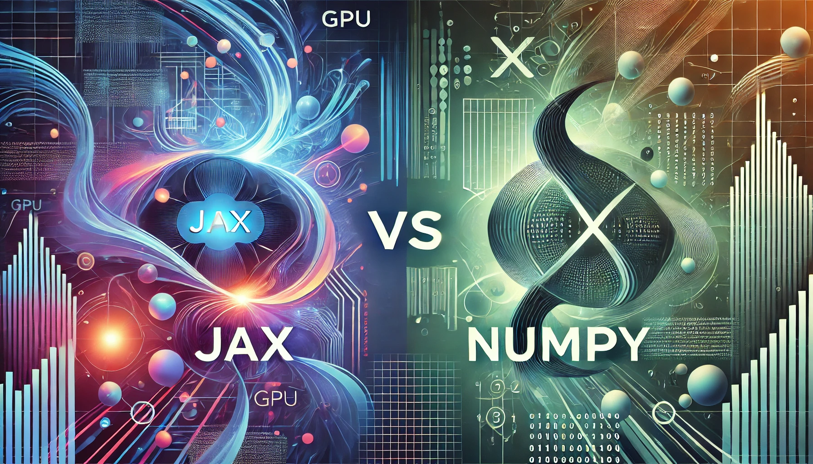
Group 2Deep 2Learn: Jazmine Brown, Varit Kobutra, Kimberly Navarrete, Phillip Torres

Slide 2
JAX ! Machine learning at warp speed!!
JAX (Just After eXecution) is a machine learning and deep learning library developed by Google DeepMind in 2018. Created as a specialized JIT (Just-In-Time) compiler, JAX converts Python and NumPy-based machine learning code into high-performance programs optimized for hardware accelerators such as GPUs and TPUs.
Built on the same tracing library as Autograd, JAX treats its operations as primitives, allowing for self-contained functionality. It also incorporates NumPy's numerical functions as primitives. The design of JAX combines the simplicity of Python with the power of modern hardware, making it a powerful tool for performing complex mathematical tasks.

Slide 3

WHY USE JAX?
Built on the same tracing library as Autograd, JAX treats its operations as primitives, allowing for self-contained functionality. It also incorporates NumPy's numerical functions as primitives. The design of JAX combines the simplicity of Python with the power of modern hardware, making it a powerful tool for performing complex mathematical tasks.
JAX has gained widespread popularity within the research community due to its efficiency and integration with machine learning frameworks like TensorFlow and PyTorch. Its primary purpose is to enable high-performance numerical computing and machine learning research by leveraging Python’s flexibility alongside the advanced capabilities of GPUs and TPUs.

Slide 4

XLA (Accelerated Linear Algebra) plays a key role in optimizing computations for TensorFlow and enables JAX to run NumPy code efficiently on GPUs and TPUs. Additionally, JAX provides a straightforward API that allows Python functions to be compiled just-in-time into XLA-optimized kernels, further enhancing performance.
Ultimately, JAX serves as a versatile tool for anyone in need of fast, flexible, and scalable computations, particularly for machine learning and scientific computing applications.

Slide 5
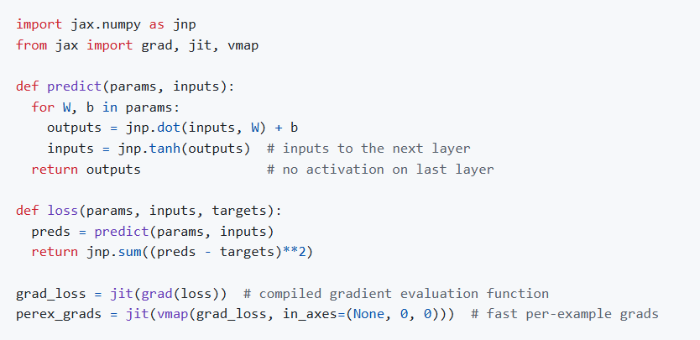
JAX INSTALL

Slide 6

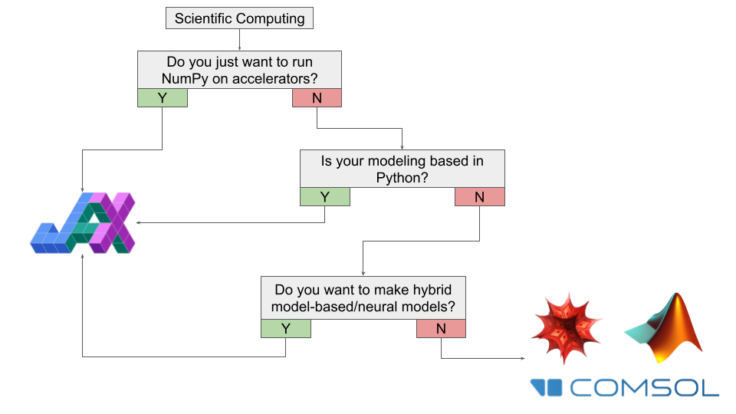
KEY FEATURES
High-performance computing
Python based coding
Updated version of Autograd
JAX can automatically differentiate native Python and NumPy functions.
Differentiate through loops, branches, recursion, and closures, and it can take derivatives of derivatives of derivatives.
Supports backpropagation
Run NumPy programs on CPU, GPUs, and TPUs

Slide 7
REAL-WORLD APPLICATIONS
Google DeepMind
Google’s infrastructure runs on Google Brain’s research breakthroughs, uses JAX.
Sequence-to-sequence learning, ability to rank search results, and serve and organize online ads.
Apple
Apple's AXLearn framework, builds on top of JAX and XLA.
Train models with high efficiency and scalability on various training hardware and cloud platforms, TPUs and GPUs.
xAI
Released Grok-1 large language model in October of 2023.
Trained from scratch using JAX and Rust.

Slide 8
JAX LINKS
How to think in JAX — JAX documentation
GitHub - jax-ml/jax: Composable transformations of Python+NumPy programs: differentiate, vectorize, JIT to GPU/TPU, and more
jax/README.md at main · jax-ml/jax · GitHub
autograd/README.md at master · HIPS/autograd · GitHub
OpenXLA Project

Slide 9
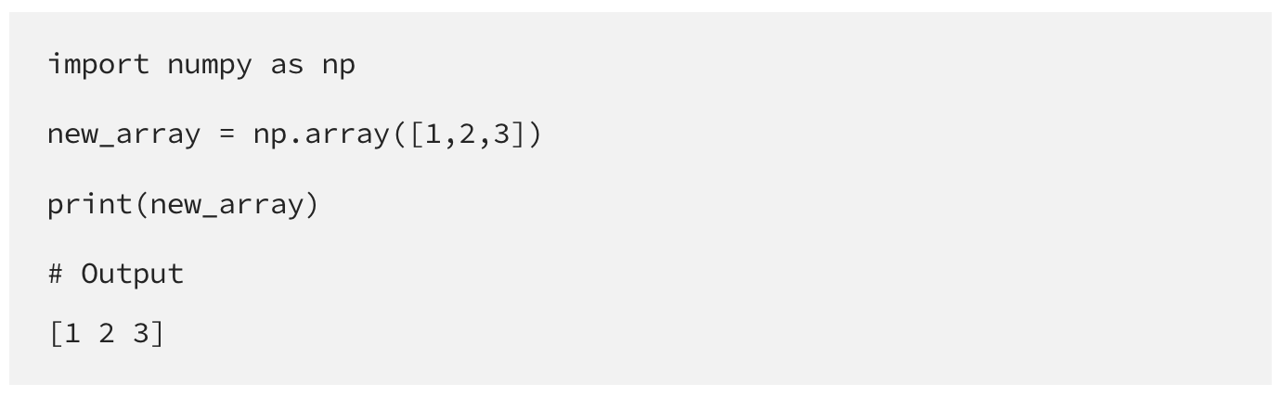
NumPy: The Foundation of Scientific Computing in Python
Origins and Development
NumPy (Numerical Python) emerged from earlier array-processing packages in Python. Initially created by Jim Hugunin at MIT in 1995 as "Numeric," it underwent significant evolution when Travis Oliphant combined features from Numeric and Numarray to create NumPy in 2005 (Harris et al., 2020). The project began with limited funding and was primarily developed by graduate students, yet it transformed into a cornerstone of scientific computing (van der Walt et al., 2011).
Purpose and Core Features
NumPy's primary purpose is to provide efficient array processing and numerical computing capabilities in Python. Its key features include:
Array Processing
Powerful n-dimensional array object (ndarray) for efficient data storage and manipulation (Harris et al., 2020)
Memory-efficient storage through homogeneous data types
Advanced array operations including reshaping, slicing, and indexing (Oliphant, 2015)

Slide 10
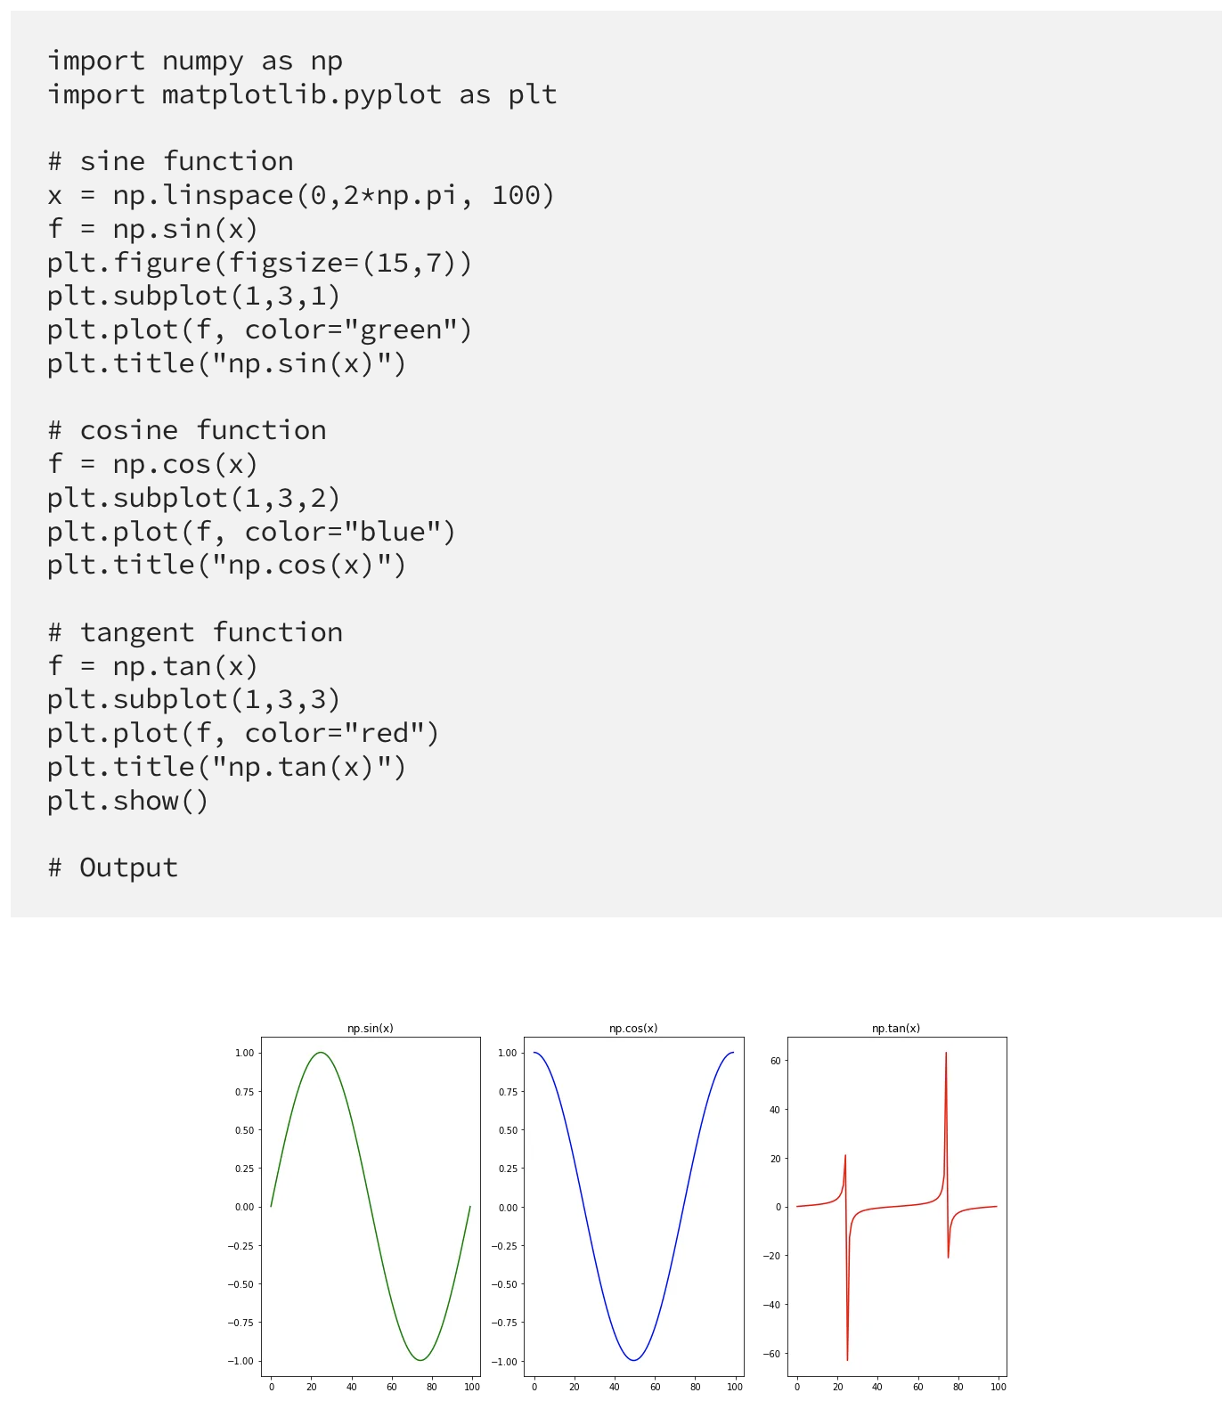
Performance Advantages
Up to 50x faster than traditional Python lists (van der Walt et al., 2011)
Optimized memory usage through contiguous storage
C/C++ backend for high-performance computations (Harris et al., 2020)
Mathematical Capabilities
Comprehensive linear algebra operations
Advanced statistical functions
Fourier transform capabilities (Virtanen et al., 2020)

Slide 11
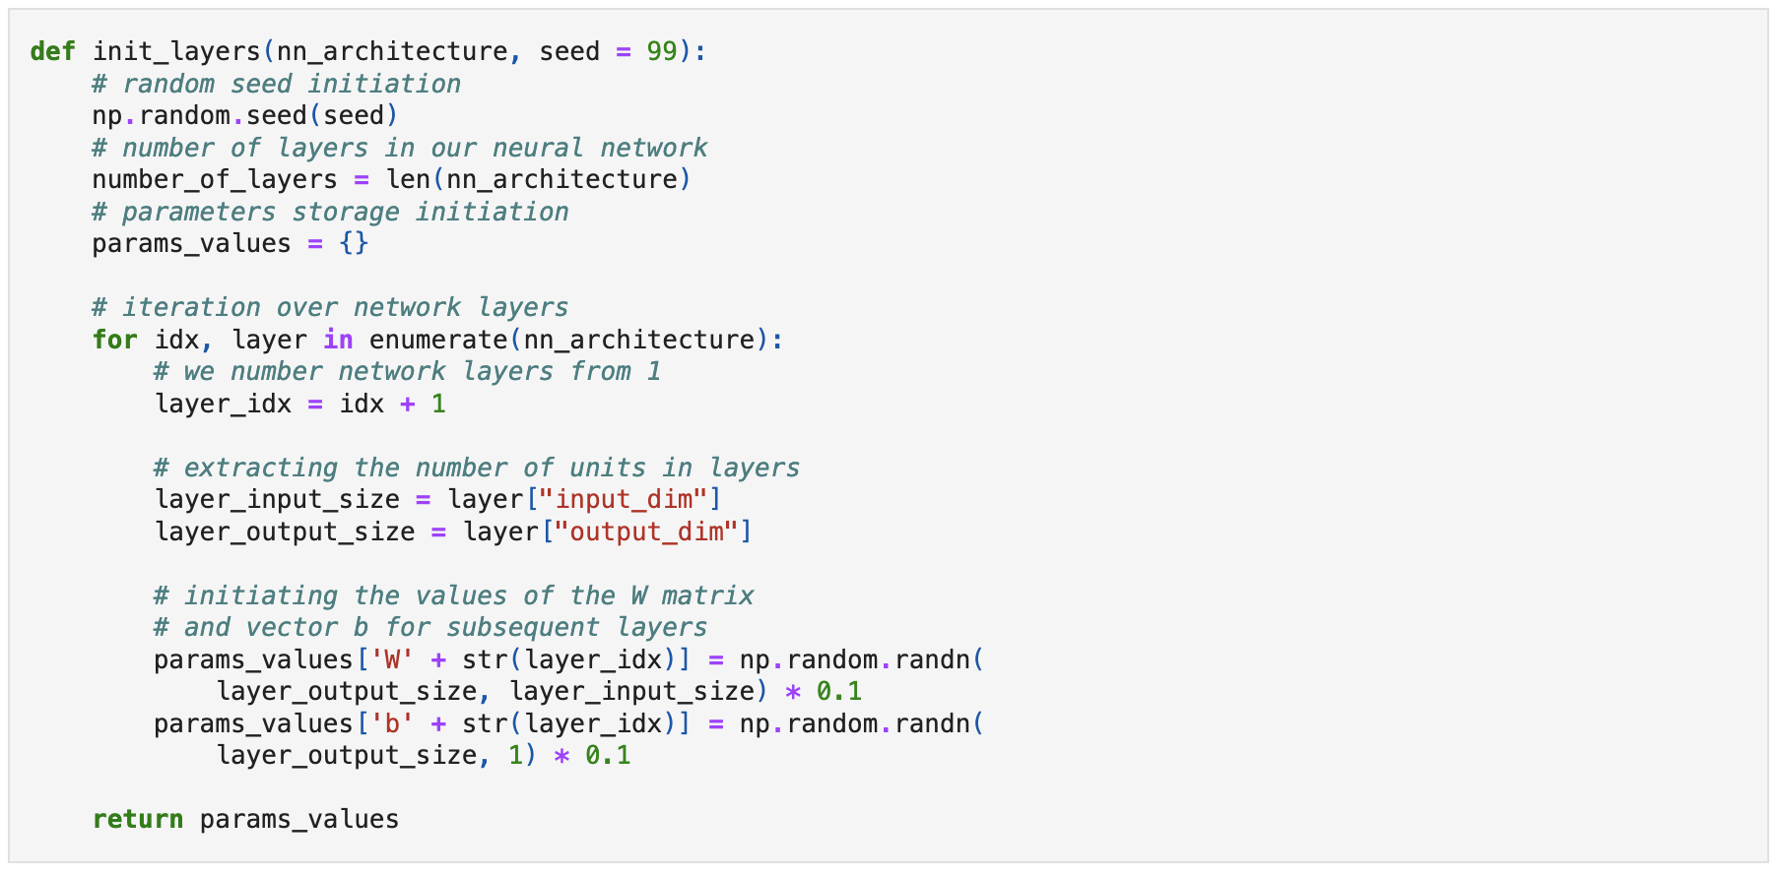
Real-World Applications
NumPy has demonstrated its effectiveness across various domains:
Scientific Research
Used in gravitational wave analysis (Abbott et al., 2016)
Instrumental in the M87 black hole imaging project (Event Horizon Telescope Collaboration, 2019)
Applied in astronomical data processing and climate science (Harris et al., 2020)
Industry Applications
Financial analysis and modeling
Image and signal processing
Machine learning and AI applications (Virtanen et al., 2020)

Slide 12
Comparative Analysis: NumPy vs JAX
Performance Characteristics
NumPy operations are CPU-bound, while JAX can leverage GPU/TPU acceleration (Harris et al., 2020)
NumPy provides immediate execution, whereas JAX uses Just-In-Time compilation for optimization (Bradbury et al., 2022)
NumPy performs better for small-scale operations due to JAX's compilation overhead
JAX excels in performance, particularly in machine learning tasks. It can run on CPUs, GPUs, and TPUs, thanks to its integration with XLA (Accelerated Linear Algebra), providing faster execution times for large-scale operations.
JAX allows users to compile Python functions just-in-time into optimized code, enabling highly efficient execution, especially for array-level operations. Its ability to run on multiple hardware platforms offers a significant performance boost compared to NumPy.
JAX can achieve up to 100x speedup over NumPy for large matrix operations when using hardware acceleration (Frostig et al., 2018)
Feature Comparison
NumPy offers mutable arrays, while JAX enforces functional programming with immutable arrays (Bradbury et al., 2022)
JAX provides automatic differentiation capabilities not available in NumPy
NumPy has a more extensive ecosystem of established scientific computing libraries
JAX requires pure functions, whereas NumPy allows side effects and in-place operations (Harris et al., 2020)

Slide 13
Development and Usage
NumPy has a more gradual learning curve and extensive documentation
JAX requires understanding of functional programming concepts
NumPy's API is more stable and well-established
JAX offers more advanced features for machine learning research and optimization
JAX is built on top of NumPy and offers a similar API, making it relatively easy for those familiar with NumPy to get started.
JAX’s advanced features like Just-In-Time (JIT) compilation and automatic differentiation (autograd) require some learning, particularly for non-experts.
JAX has more complex functionality for machine learning applications, requiring additional annotation (such as the jit_ps decorator) to enable advanced features, which might increase the learning curve.
Integration Capabilities
NumPy serves as the foundation for traditional scientific computing libraries (Pandas, Matplotlib, SciPy)
JAX integrates well with modern ML frameworks and Google Cloud TPUs
Both libraries support interoperability with each other, allowing gradual migration (Bradbury et al., 2022)
NumPy has broader support in legacy scientific computing applications
JAX is designed for scalability and is a powerful tool for large-scale machine learning and scientific computing tasks. Thanks to its integration with XLA, JAX can scale across multiple CPUs, GPUs, and TPUs, making it ideal for high-performance computations in machine learning.
JAX is built with distributed programming in mind, supporting operations like map_reduce and parallel computation through features like pmap (parallel mapping), which allow for efficient scaling in large models and datasets.

Slide 14
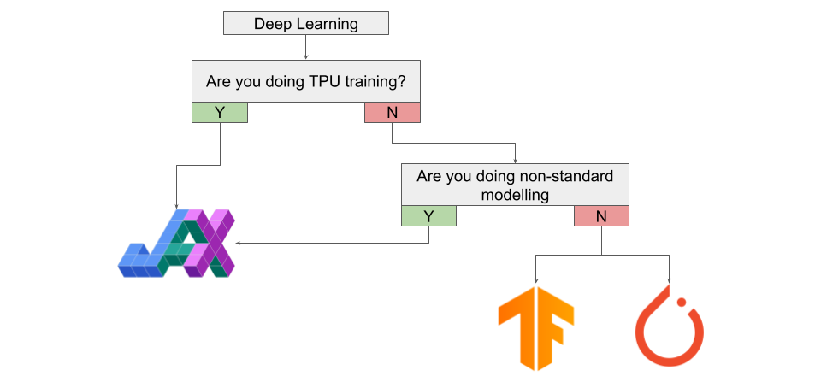

Extra [Delete if not used]

